Slide 1
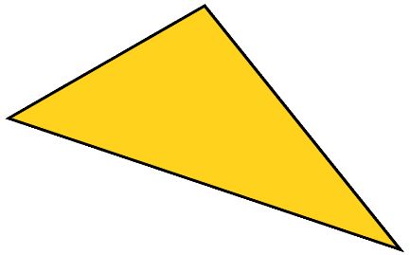
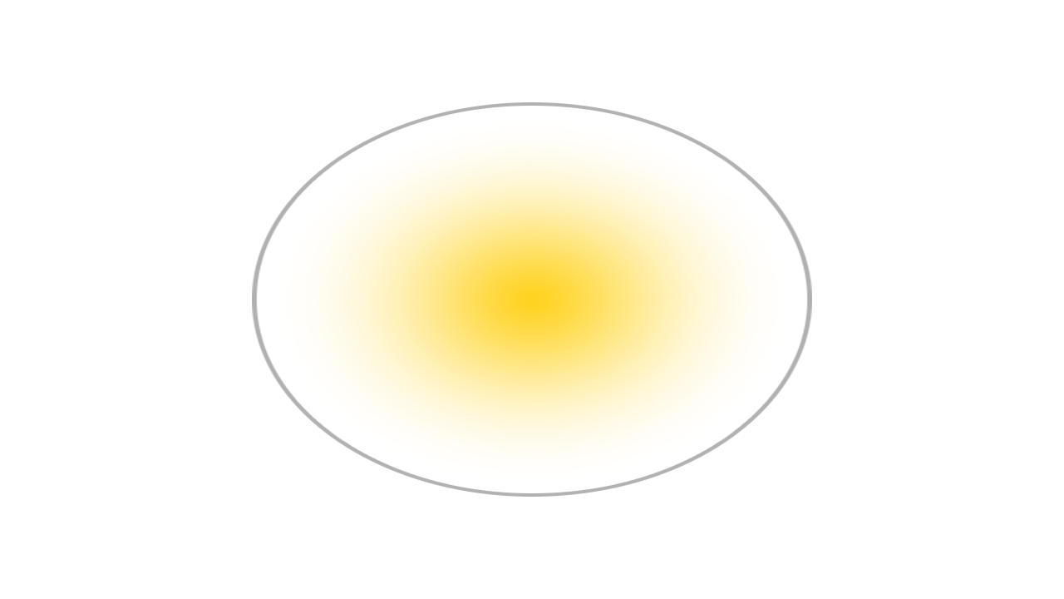
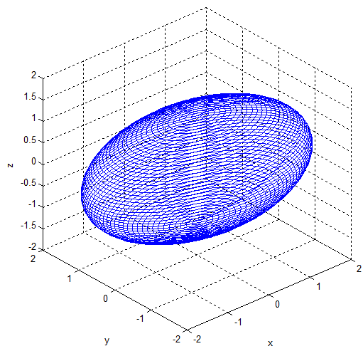
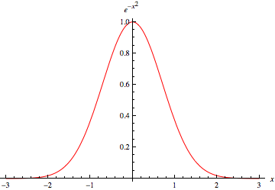
Capturing, Editing and Merging Gaussian Splats to Create Novel 3D Environments
How can Gaussian Splats be edited and merged to create novel and visually impressive 3D environments for use in game development and beyond?

Slide 2
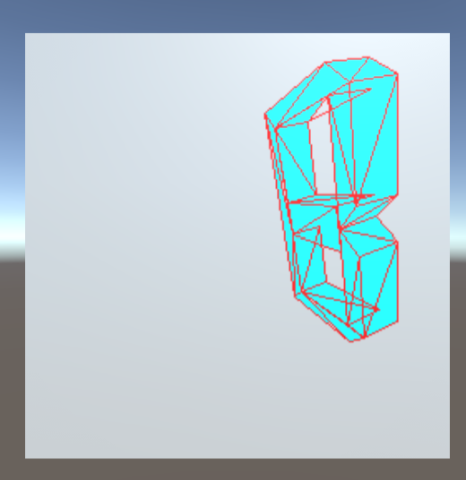
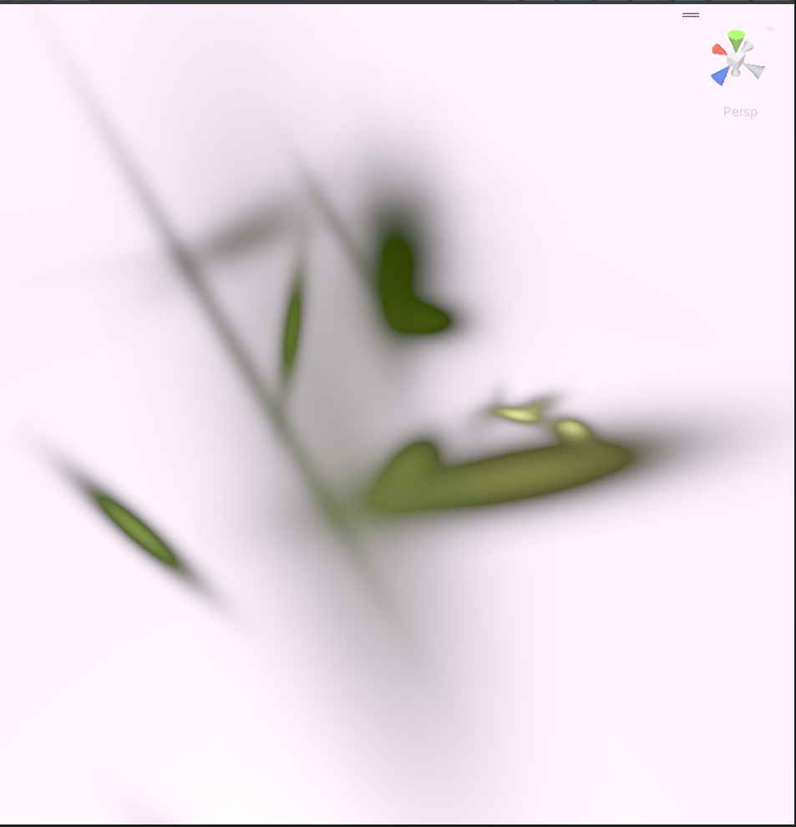
What is a Gaussian Splat?
Gaussian Splat of bench outside Tom Crean Business Centre.
From the video-game Horizon Forbidden West.
SuperSplat
Traditional Geometry
Zoomed in Splats

Slide 3
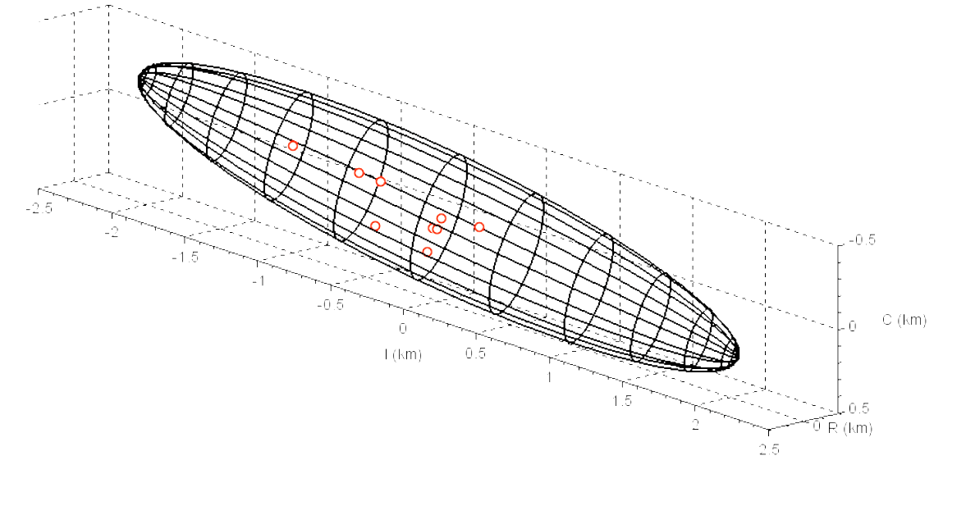
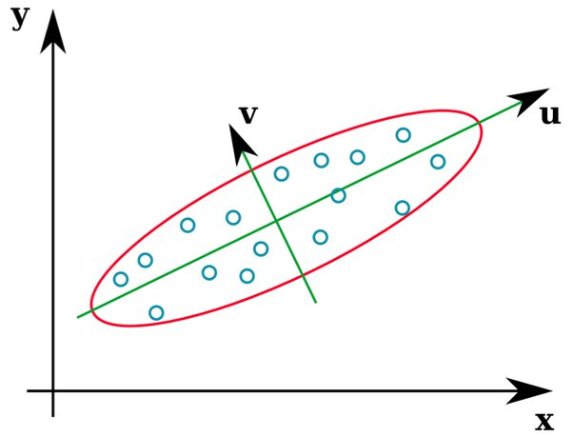
How Do We Make Them?
A Gaussian Splat is created from an image set using multiple processes:
Camera tracked in 3D space using Structure From Motion (SFM):
Reconstructs camera positions and orientations from images.
Key features in the scene are identified and tracked across the images in 3D space.
A Gaussian function is used to assign properties to these features based on the images:
Captures shape, size, colour, and intensity.
Splats are computed in 3D for accuracy, then projected into 2D for rendering.
Each splat is assigned:
Position (3D coordinates)
Colour (RGBA)
A 3x3 covariance matrix (𝑥, 𝑦, 𝑧), defines how much the splat changes on each axis & how the axes are linked.
Weight (importance/ blending factor)

Slide 4
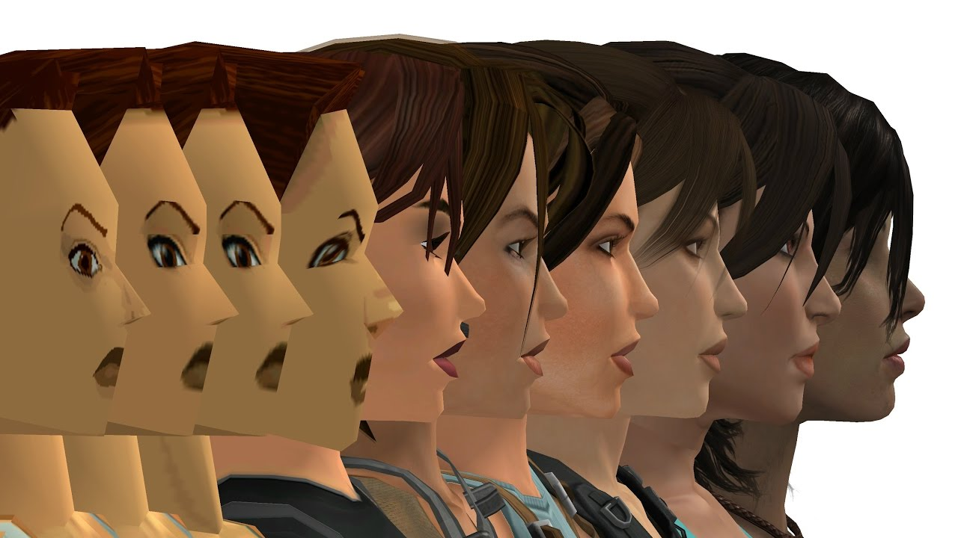
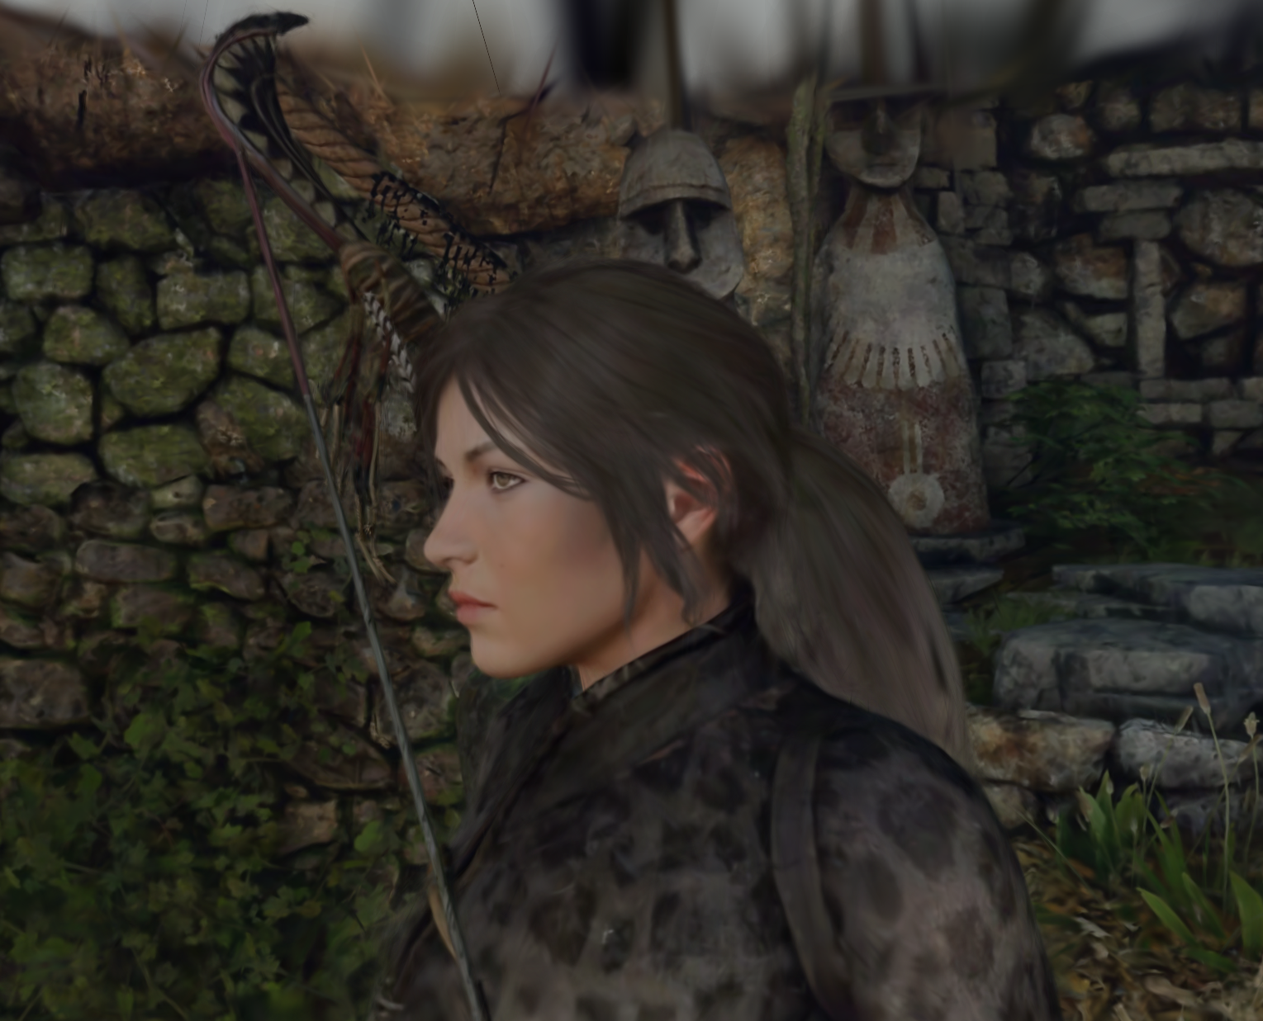
Traditional Geometry vs. Gaussian Splatting
Traditional Geometry-Based Pipeline
Collisions: Well-supported and precise
Flexibility: Easy to edit, widely compatible
Mass Use: Scalable for large, interactive scenes
Gaussian Splatting
Efficiency: Lightweight, small file sizes and fast for static scenes
Realism: Captures fine details and soft edges
Speed: Quick to create from simple image data
Editability: Quickly move, delete, combine Splats for unique scenes.
Conclusion:
Geometry: Best for dynamic, interactive content
Splatting: Ideal for static, visual focussed scenes
Lara Croft over the years
Gaussian Splat of Lara Croft

Slide 5
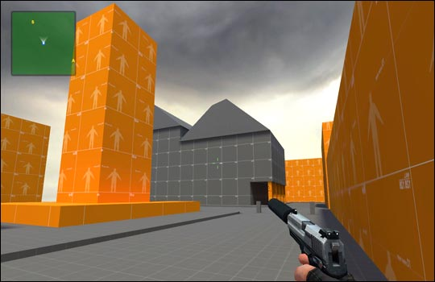
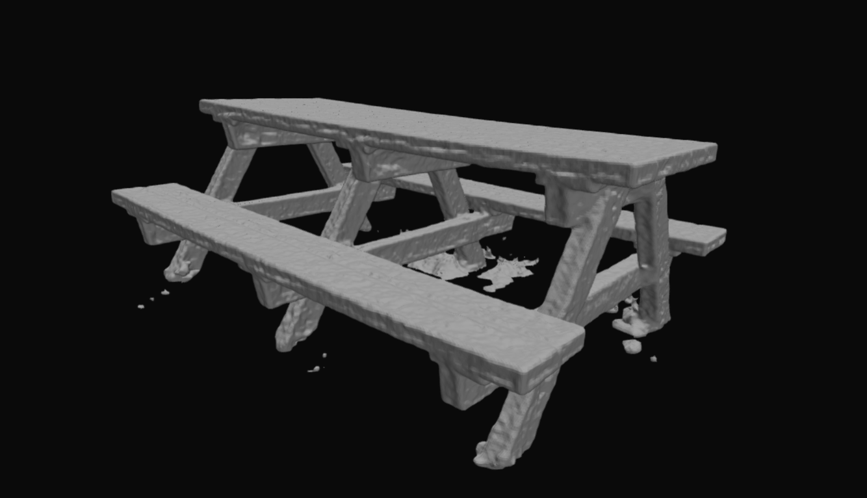
Use Cases: What it’s not
Video-game background environments
Alternative genre/ unique art style video-games
Rapid environment blocking out
Virtual tourism, training simulations, and historical preservation.
Visualisation and conceptualisation of scenes
Fast asset placement and scene composition
Virtual production and previsualisation (Restricted area filming)
Where now?
Overcoming the collision limitations using genetic algorithm and NeRF.
Expand tools to interact/ edit with Gaussian Splats.

